Slide 1

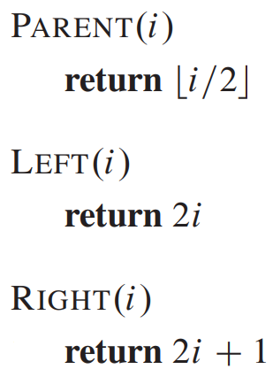
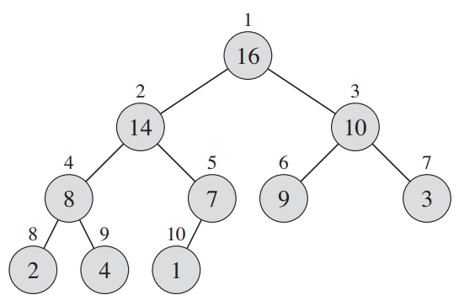

Slide 2

NODE $i$

Slide 3
NODE $i$
LEFT(i)
RIGHT(i)

Slide 4
PARENT(i)
NODE $i$
LEFT(i)
RIGHT(i)

Slide 5
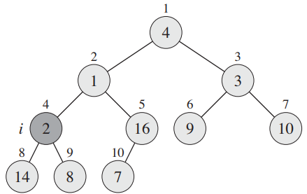
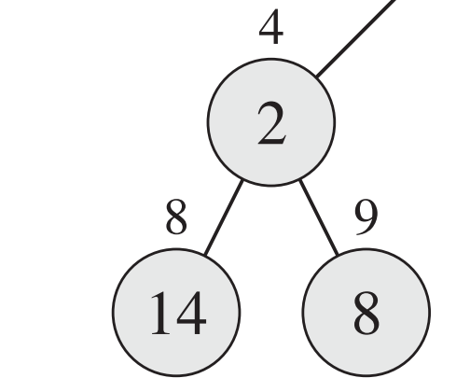
Satisfies max-heap property
Does not satisfy max-heap property

Slide 6
Root
A
Level 0
B
C
Level 1
Parent Node
D
E
F
Siblings
G
Level 2
Child Node
H
I
J
Level 3
Sub-tree
Leaf Node

Slide 7
16
14
10
8
7
9
3
2
4
1

Slide 8
1
1
2
3
14
10
4
5
6
7
8
7
9
3
8
9
2
4

Slide 9
1
14
2
3
1
10
4
5
6
7
8
7
9
3
8
9
2
4

Slide 10
1
14
2
3
8
10
4
5
6
7
1
7
9
3
8
9
2
4

Slide 11
1
14
2
3
8
10
4
5
6
7
4
7
9
3
8
9
2
1

Slide 12
1
14
2
3
8
10
4
5
6
7
4
7
9
3
8
9
10
2
1
12

Slide 13
1
14
2
3
8
10
4
5
6
7
4
12
9
3
8
9
10
2
1
7

Slide 14
1
14
2
3
12
10
4
5
6
7
4
8
9
3
8
9
10
2
1
7

Slide 15
5
5

Slide 16
7
7
5

Slide 17
6
7
6
5

Slide 18
3
7
6
5
3

Slide 19
3
7
6
5
3

Slide 20
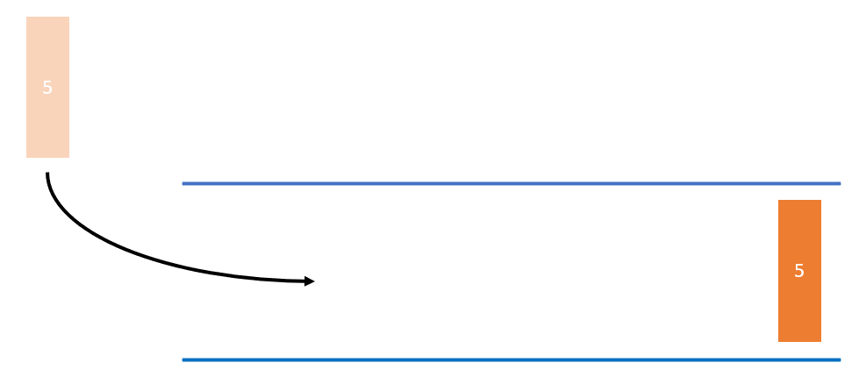
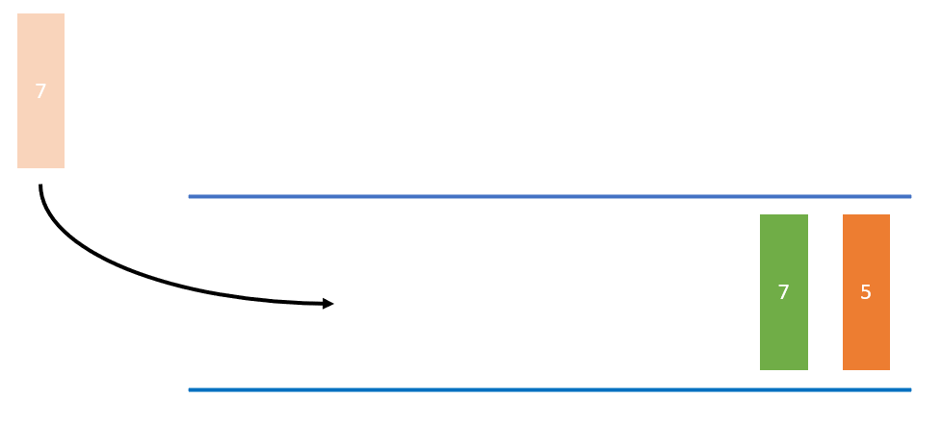
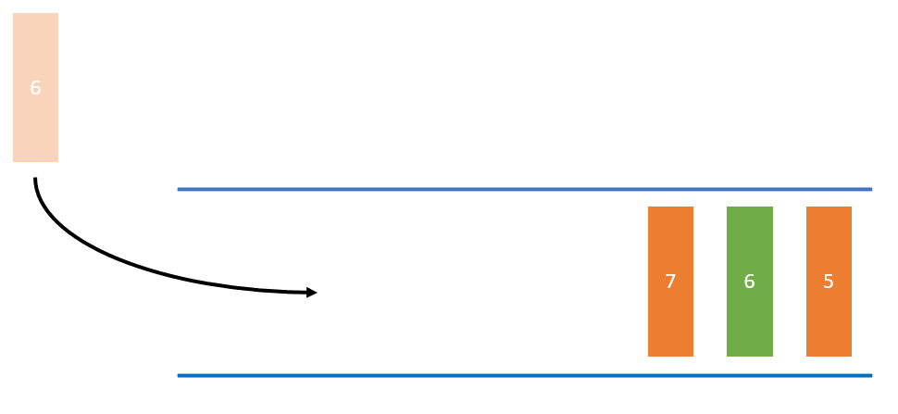
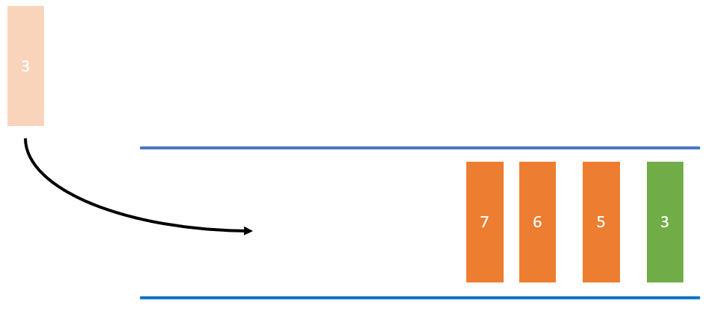
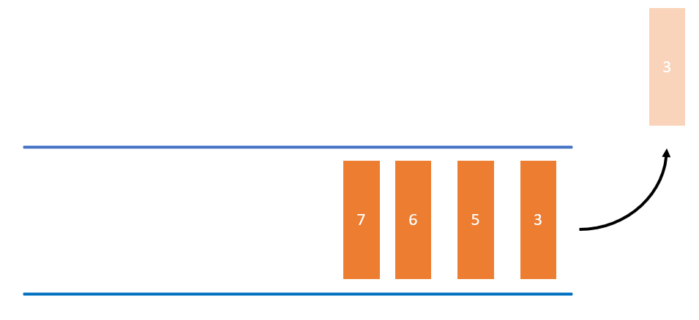
enqueue() Item 5
enqueue()
Item 7
enqueue()
Item 6
enqueue()
Item 3
dequeue()
Item 3 (highest priority)

